Slide 1



SBME
UBC
Synthetic Biology
BMEG 426
Kalaimaran Balasothy
Notes:
Hi, my name is Kalaimaran Balasothy and this is my final presentation for BMEG 426 where I will explain the scientific story we covered in this course as well as the fundamental biological concepts behind it.

Slide 2
Table of Contents
I
Research Background
II
Hypothesis & Objectives
III
Methodology
IV
Results
V
Conclusion & Discussion
Notes:
I’ll start by going over an overview. I’ll explain the key biological principles for this course, followed by my hypothesis & methodology. Finally I’ll discuss my results and conclusion.

Slide 3
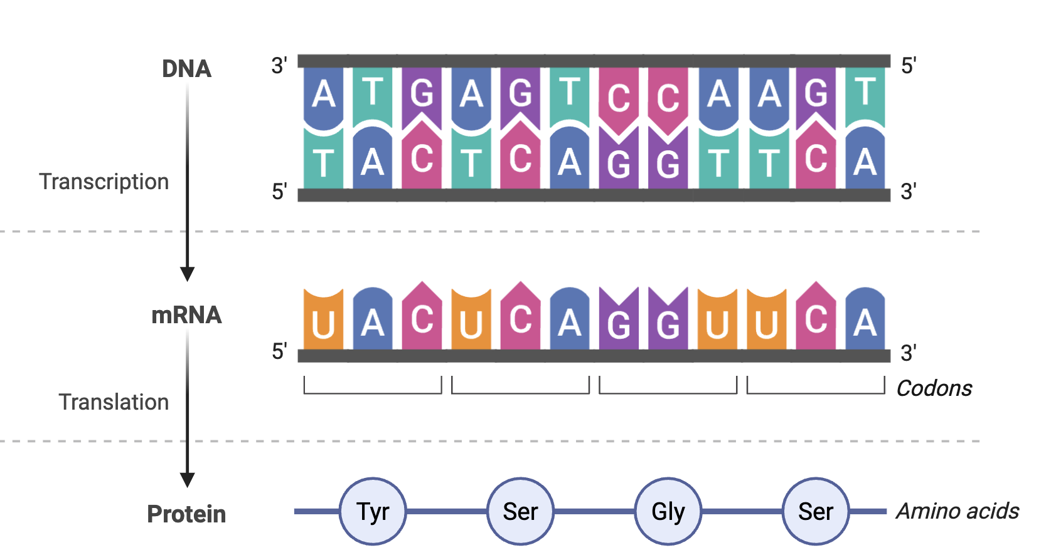
I
Research Background
Introduction
Cells are simply complex computers that we’re slowly learning how to program
DNA is the fundamental unit of life → One that we are now slowly being able to write
The experiment in this course is focused on producing a genetic device & testing it via injecting it in a mammalian cell.
Notes:
This course is built around the principle that cells are just fancy little computers that we’re slowly learning how to program. As engineers, our goal is to produce genetic devices that can utilize the central dogma and respond in a predictable and controllable fashion. We’ll understand the success of our work by injecting our devices into mammalian cells.

Slide 4
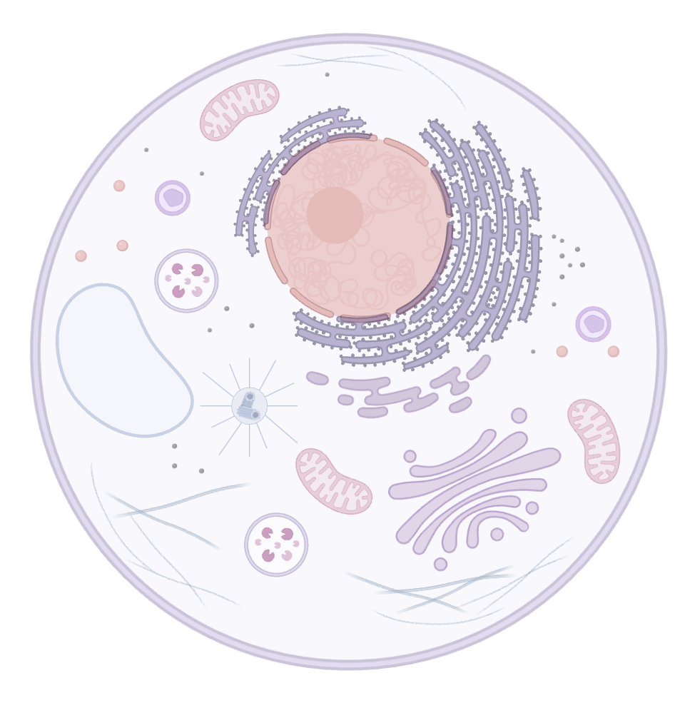
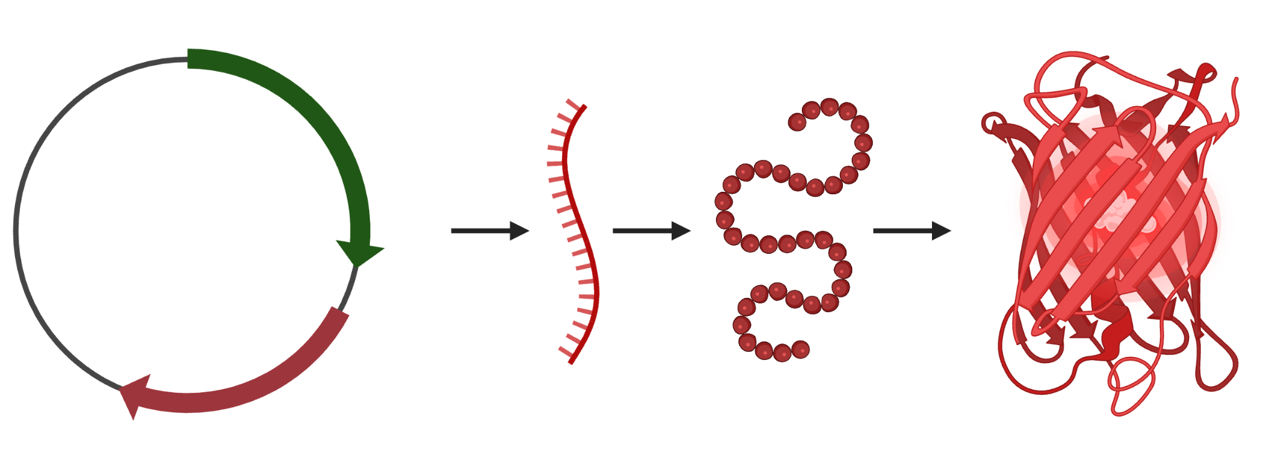
I
Research Background
A DNA plasmid consisting of crucially a promoter & gene for both a subcellular tag & fluorescent protein
The cell will produce the protein which will then tag a particular location (eg. the nucleus).
Notes:
The core biological principle for our project was this. We would design a plasmid (promoter in green and protein encoding gene in red) which when transcripted will produce an mRNA that encodes for a protein. The quaternary structure will include the fluorophore and a tag, allowing us to colour in a specific subcellular region.

Slide 5
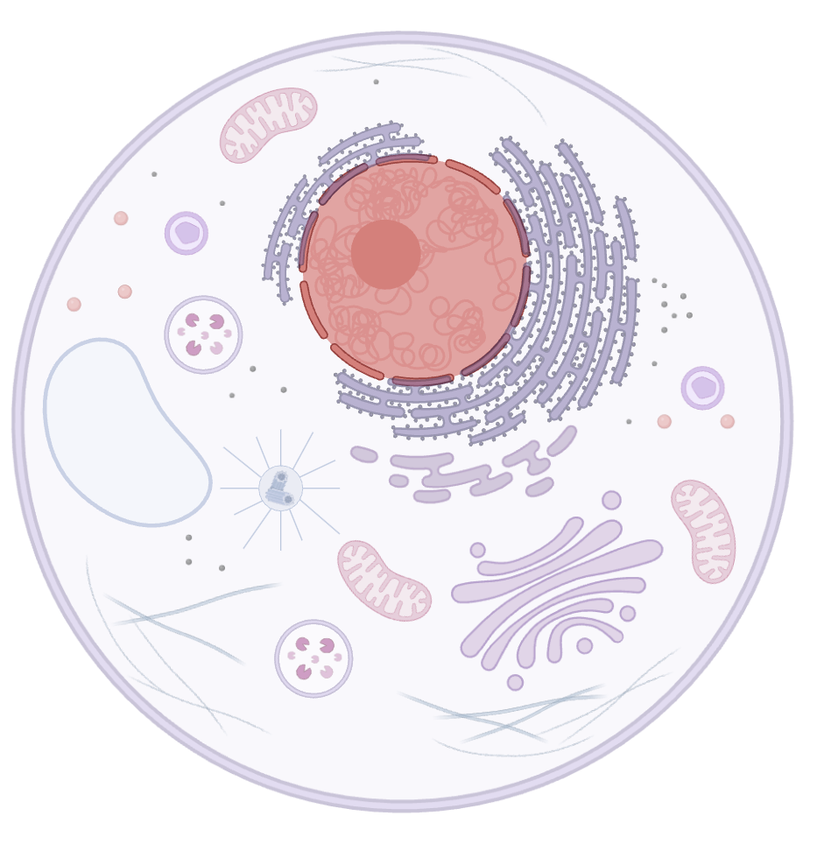
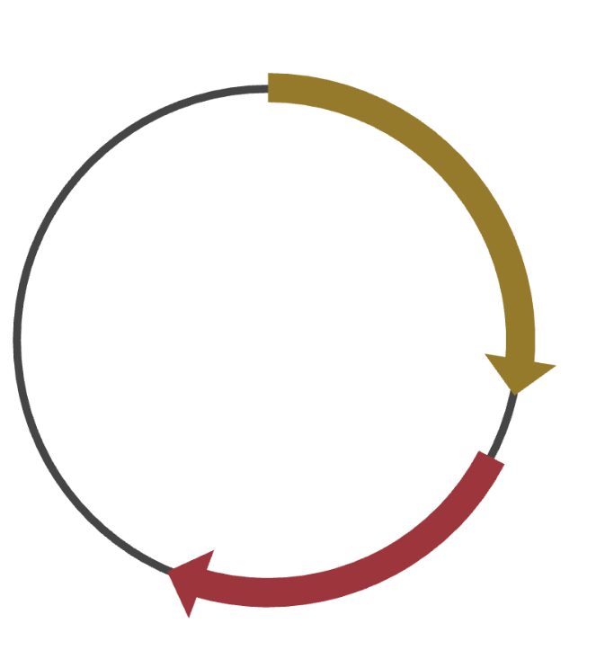
I
Research Background
A DNA plasmid consisting of crucially a promoter & gene for both a subcellular tag & fluorescent protein
The cell will produce the protein which will then tag a particular location (eg. the nucleus).
By changing the constitutively active promoter we can identify if it changes expression (eg. increases production so brighter fluorescence)
Notes:
The objective of our experiments is to see if we can change the constitutively active promoter to lead to an expression change (such as an increasing protein production for stronger expression)

Slide 6
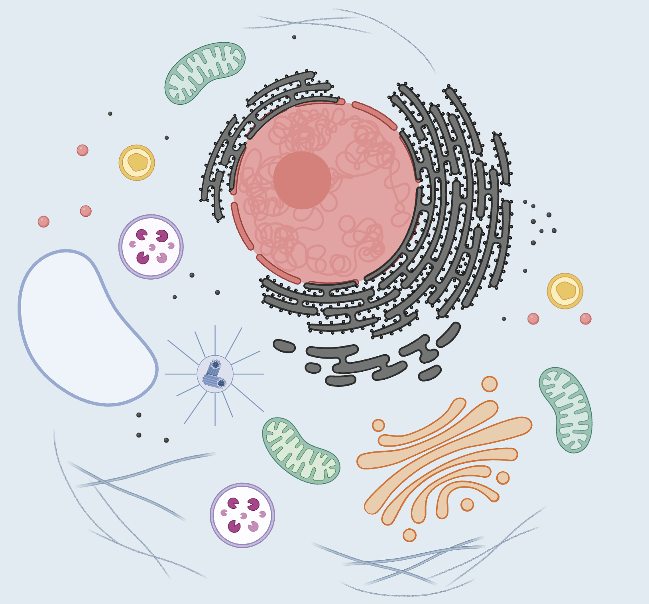
I
Research Background
The end goal is to create a catalog of genetic devices where each device uniquely tags a subcellular region with a unique colour → a cellular painting in other words.

Slide 7
Central Question
II
Hypothesis & Objectives
How do different constitutively active promoters impact the level of expression of our protein of interest?

Slide 8
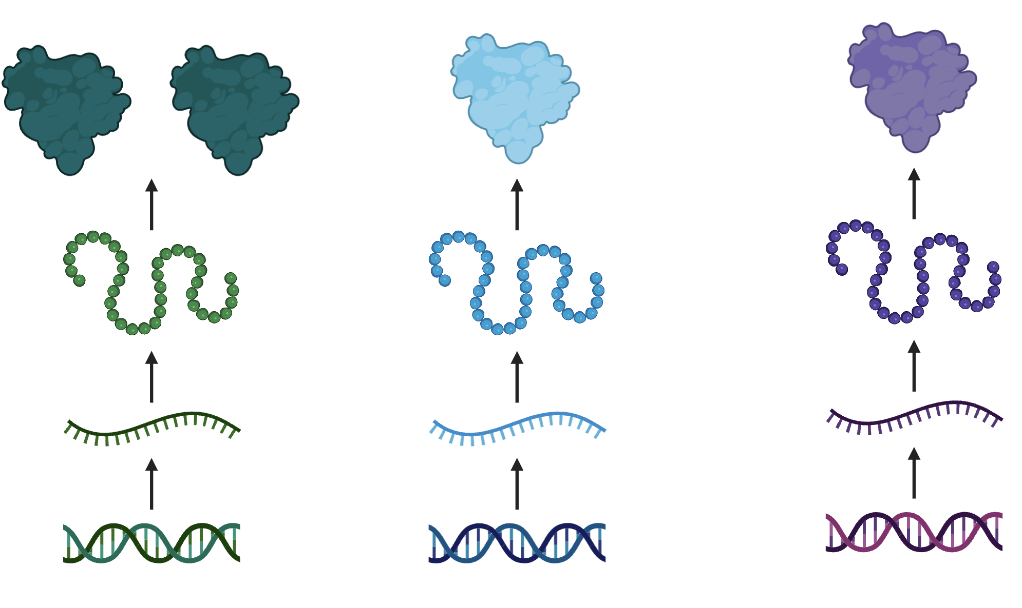
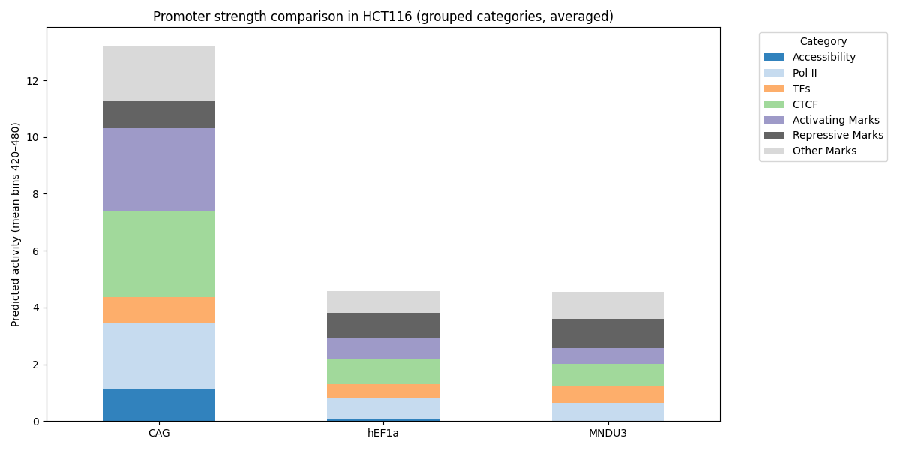
II
Hypothesis & Objectives
Hypothesis
Using Enformer, I hypothesize that CAG will lead to the highest expression with hEF1a & MNDU3 having similar levels
CAG
hEF1a
MNDU3
CAG
hEF1a
MNDU3
Notes:
To make a reasonable hypothesis for this experiment, I searched for research papers that could compare our 3 promoters. However there was no single paper that compared the 3 promoters. To remain consistent among our comparison I chose an alternative approach. Enformer is a model that was recently released (not peer reviewed yet) that can predict gene expression. As a reference point I ran this model on my device and it predicted that CAG would have the highest expression, followed by hEF1a and MNDU3.

Slide 9
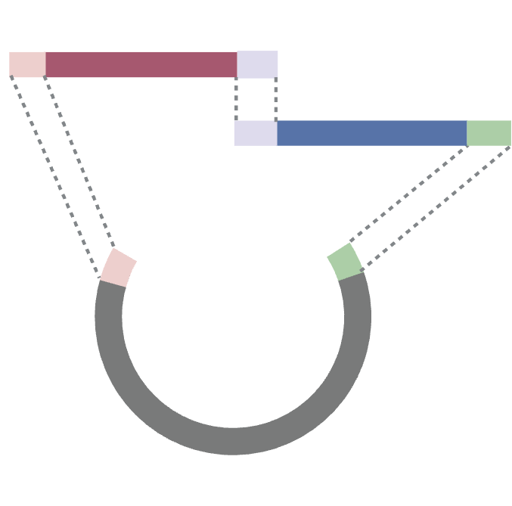
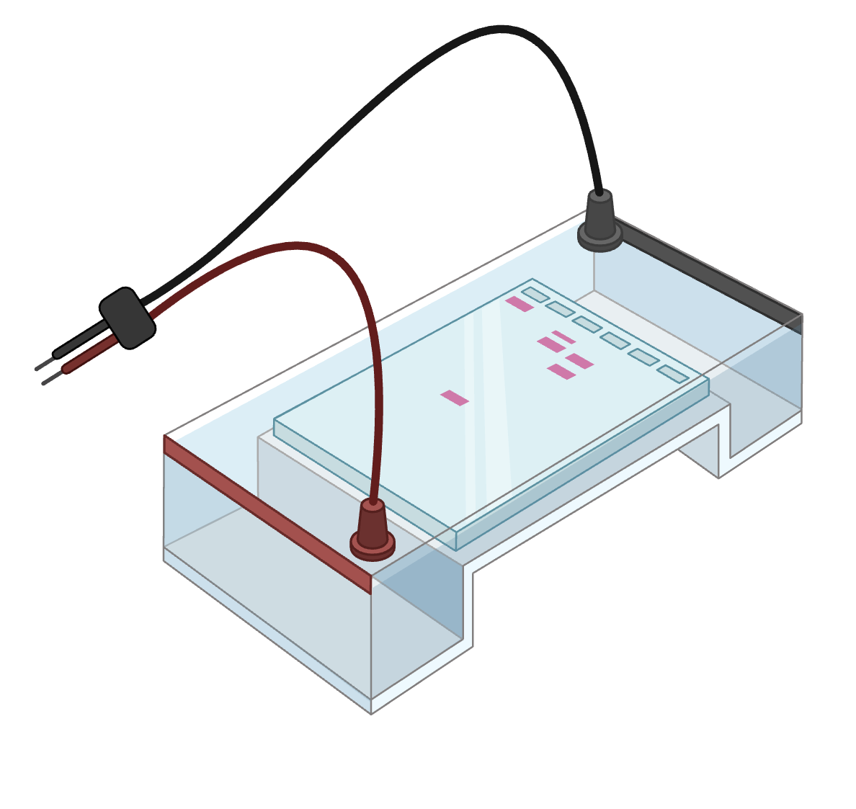
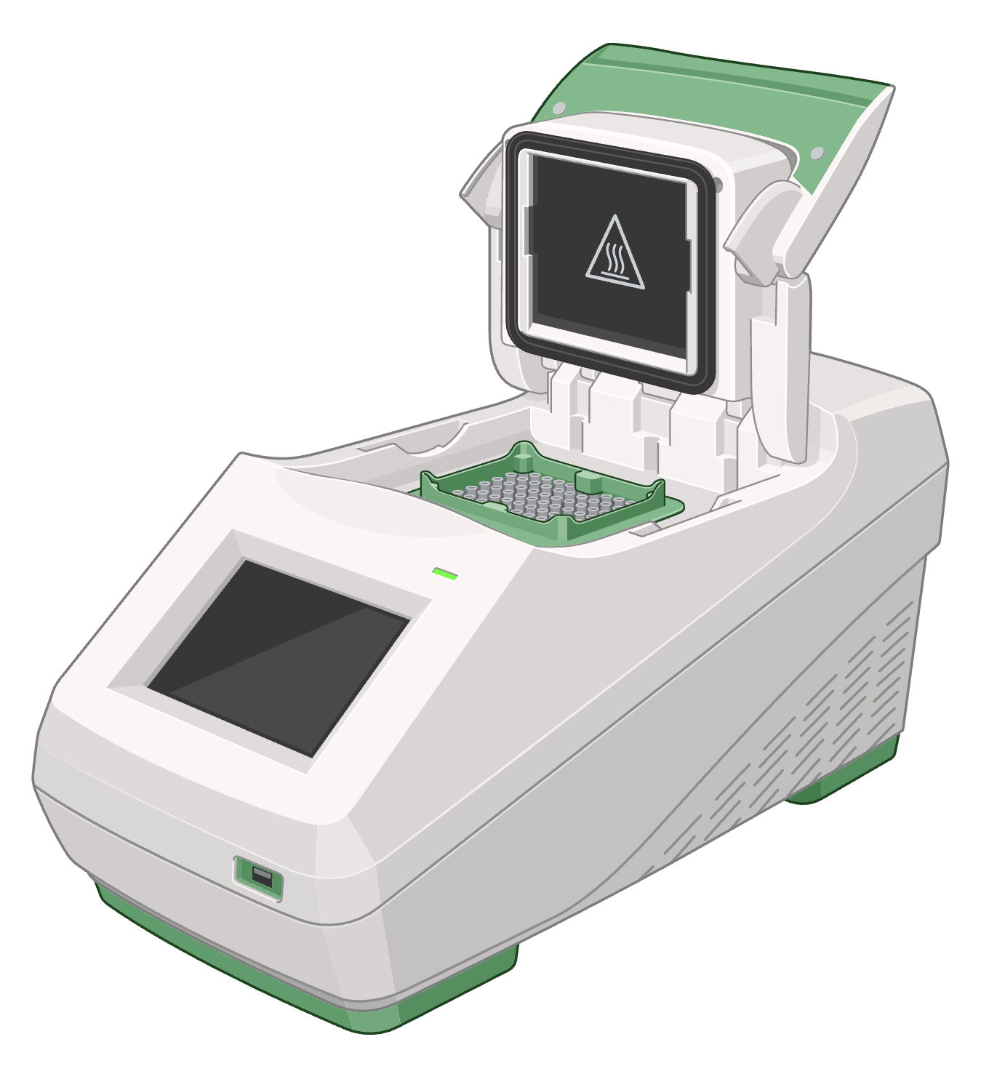
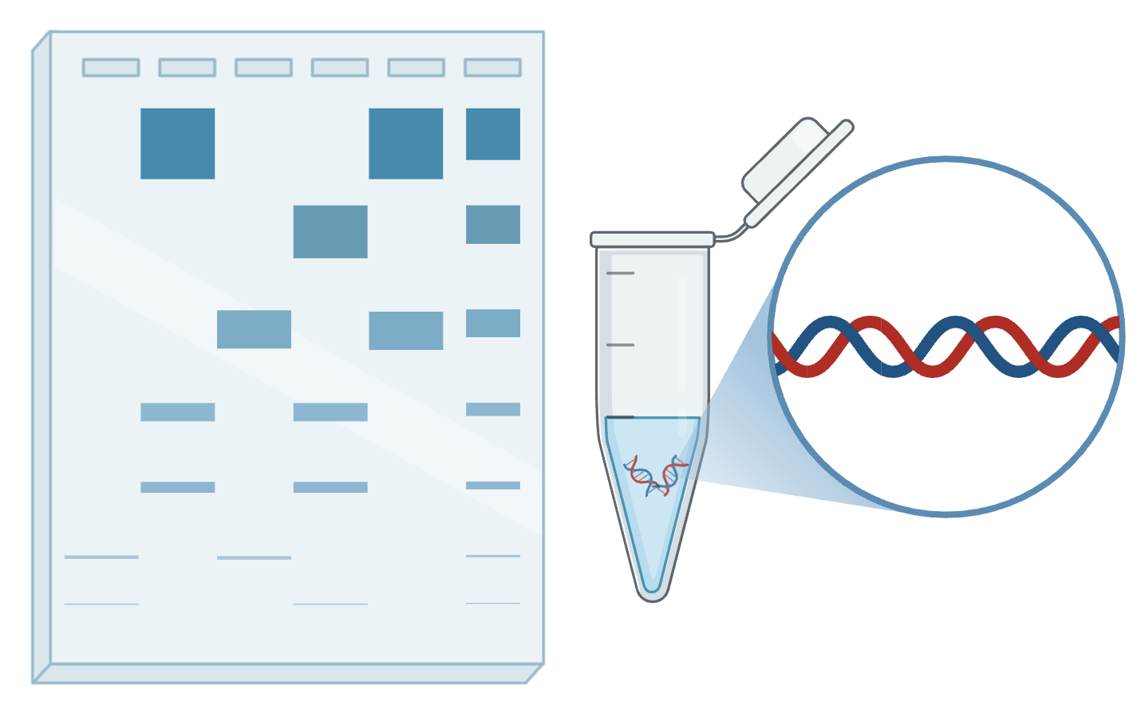
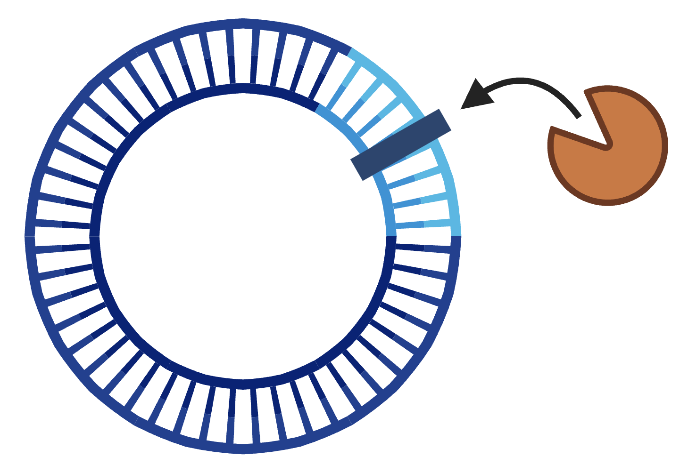
III
Methodology
Experiment Timeline (1/3)
1
2
3
4
4
PCR for DNA Production
Preparing & running gel
Gel Purification
Gibson Assembly
DNA Digestion with Dpn1
Notes:
The first step in our experiment to validate our hypothesis was to run a PCR to duplicate both our tag sequence and fluorophore sequence. Next we took our results and ran it through a gel to validate the accuracy of our production. Once confirmed we extracted our bands of interest and purified the DNA from it. Then we performed a gibson reaction to paste our two sequences (tag & fluorophore) together into the backbone. Finally to clean up our DNA, we ran a digestion with Dpn1 to get rid of an template DNA remaining.

Slide 10
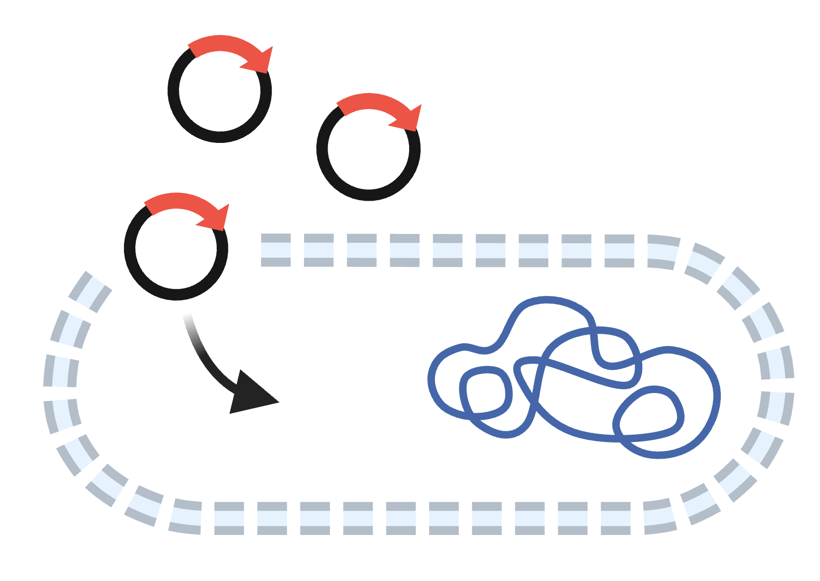
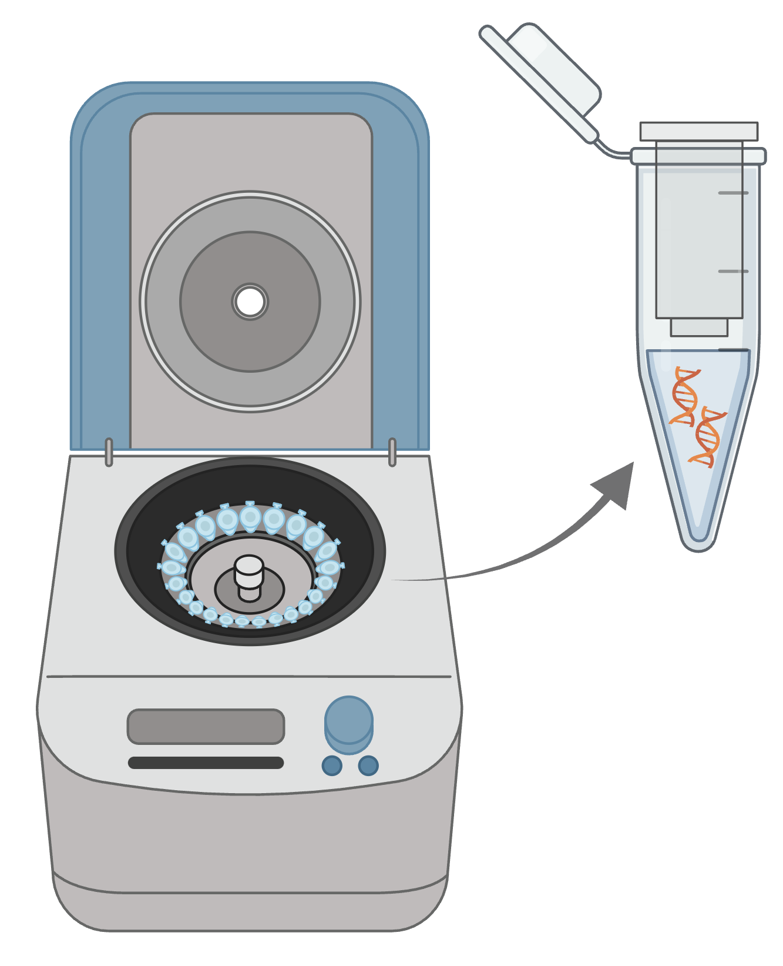
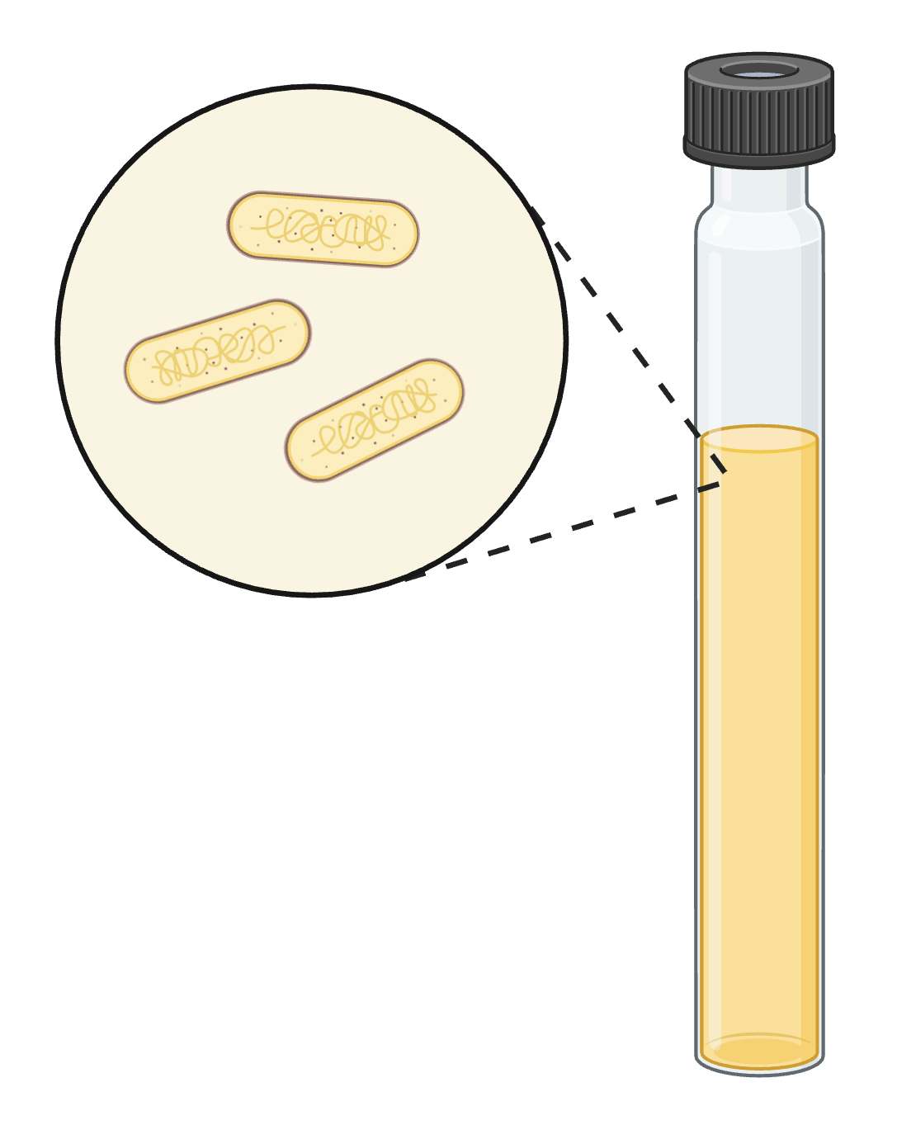
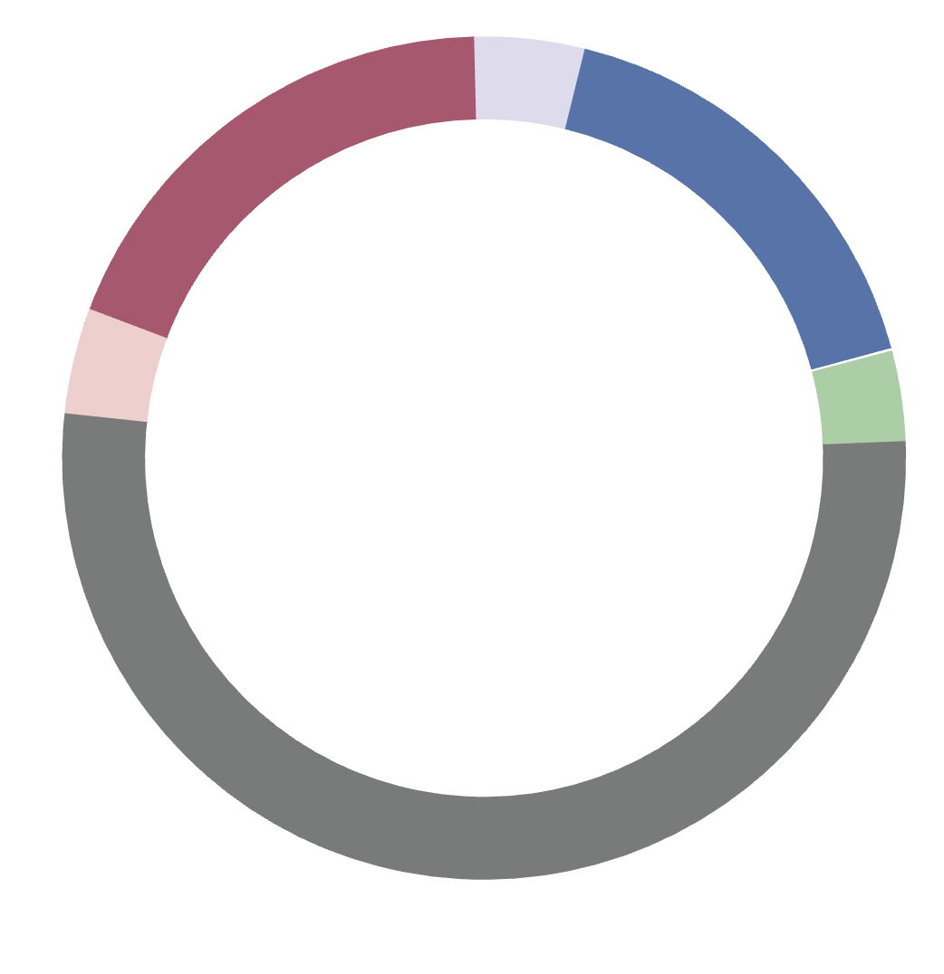
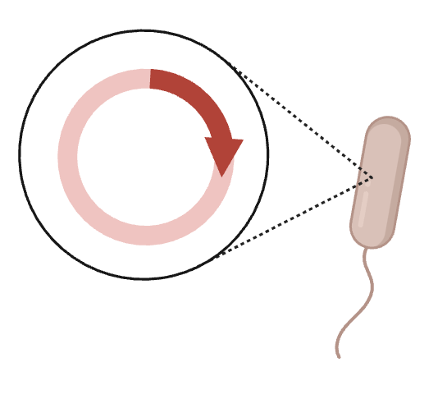
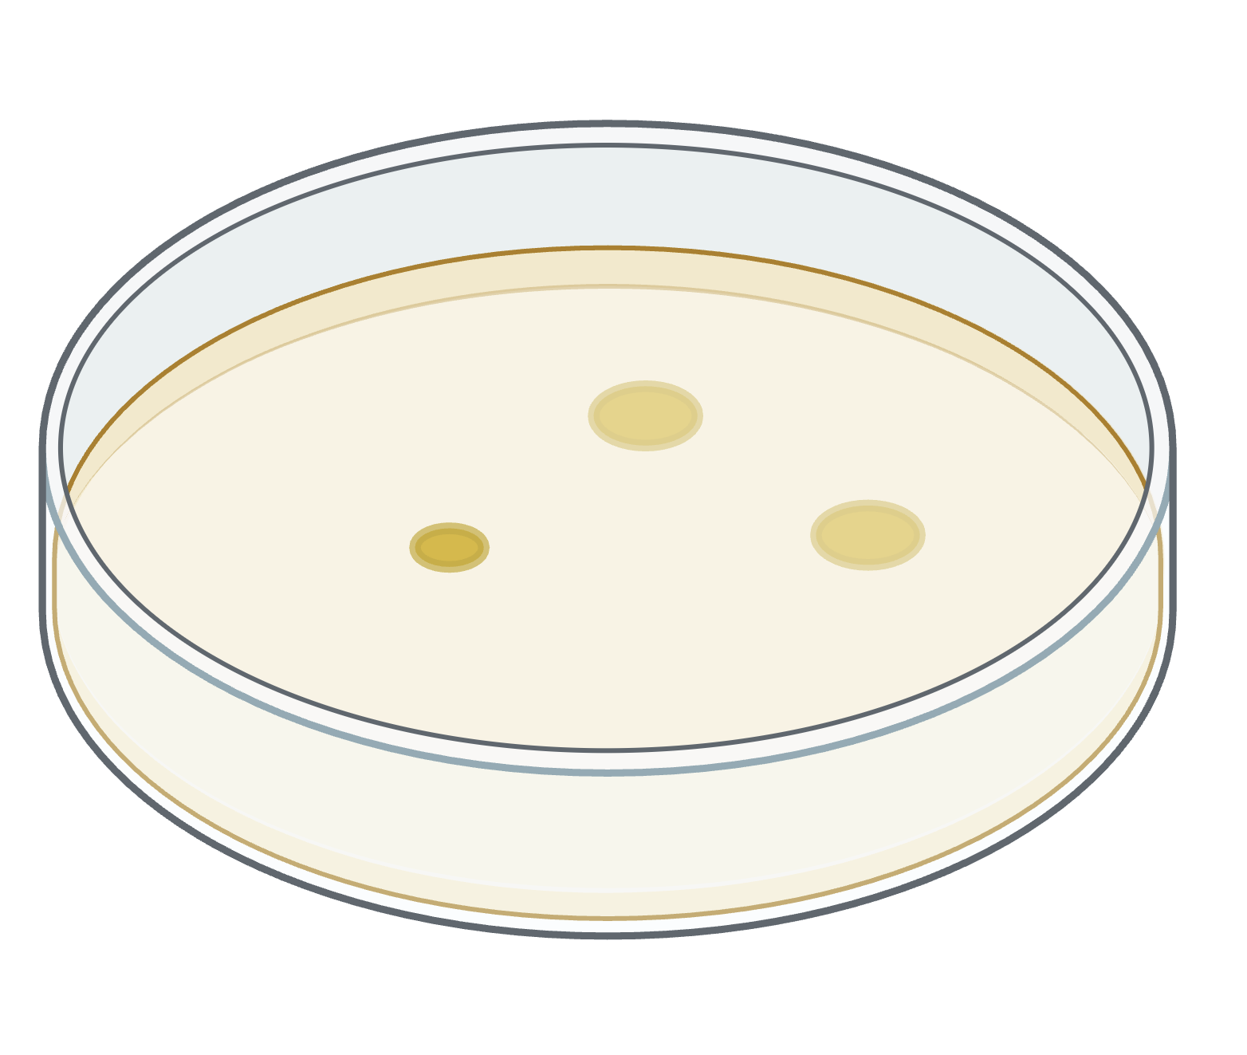
III
Methodology
Experiment Timeline (2/3)
6
7
8
9
10
Bacterial Transformation
Liquid Bacterial Culture
Miniprep
Golden Gate Assembly
Bacterial Transformation with Device
Notes:
Once we had our first plasmid of interest we performed heat shock to place it into bacteria and then grow it on agar plates. After incubating overnight we selected a single colony and placed it in a liquid bacteria culture to replicate our plasmid of interest. After allowing for overnight growth we ran miniprep to extract our plasmid DNA from the bacteria. Once we isolated and quantified our DNA using nanodrop spectrophotometer, we performed a golden gate assembly. The golden gate was run with our level 0 plasmid along with prebuilt plasmids for the promoter, terminator, backbone and other components. Finally we placed that into bacteria to replicate our plasmid of interest.

Slide 11
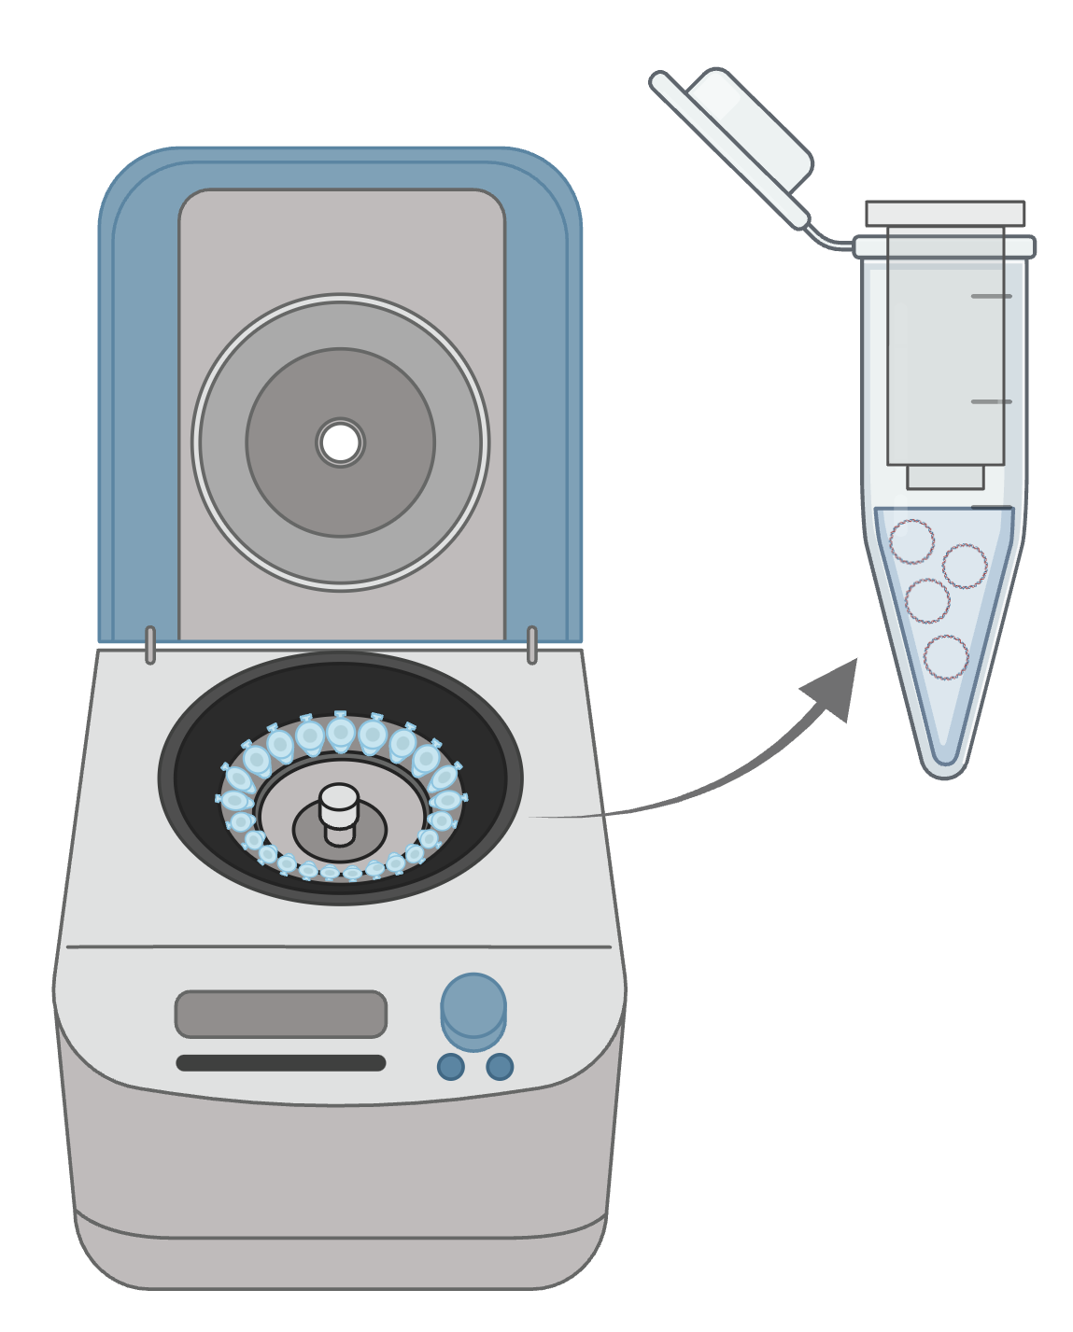
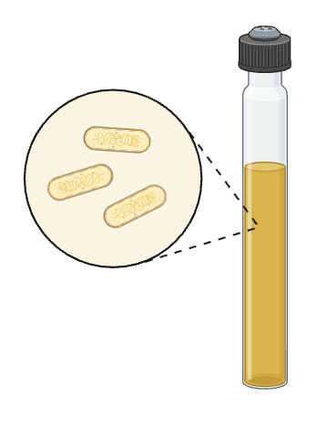

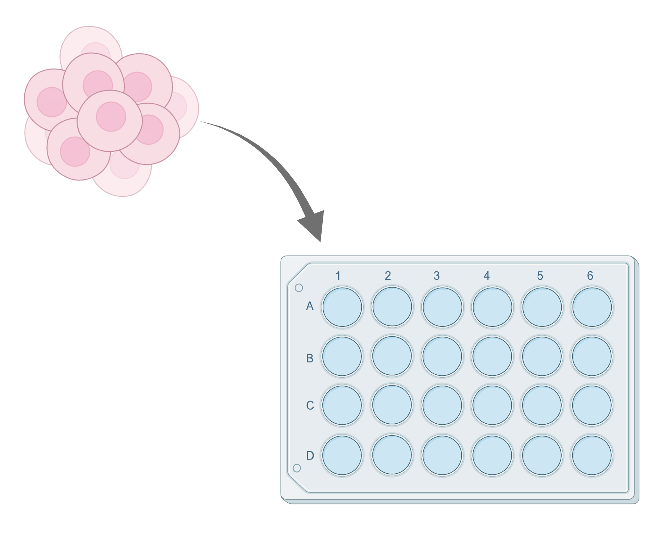
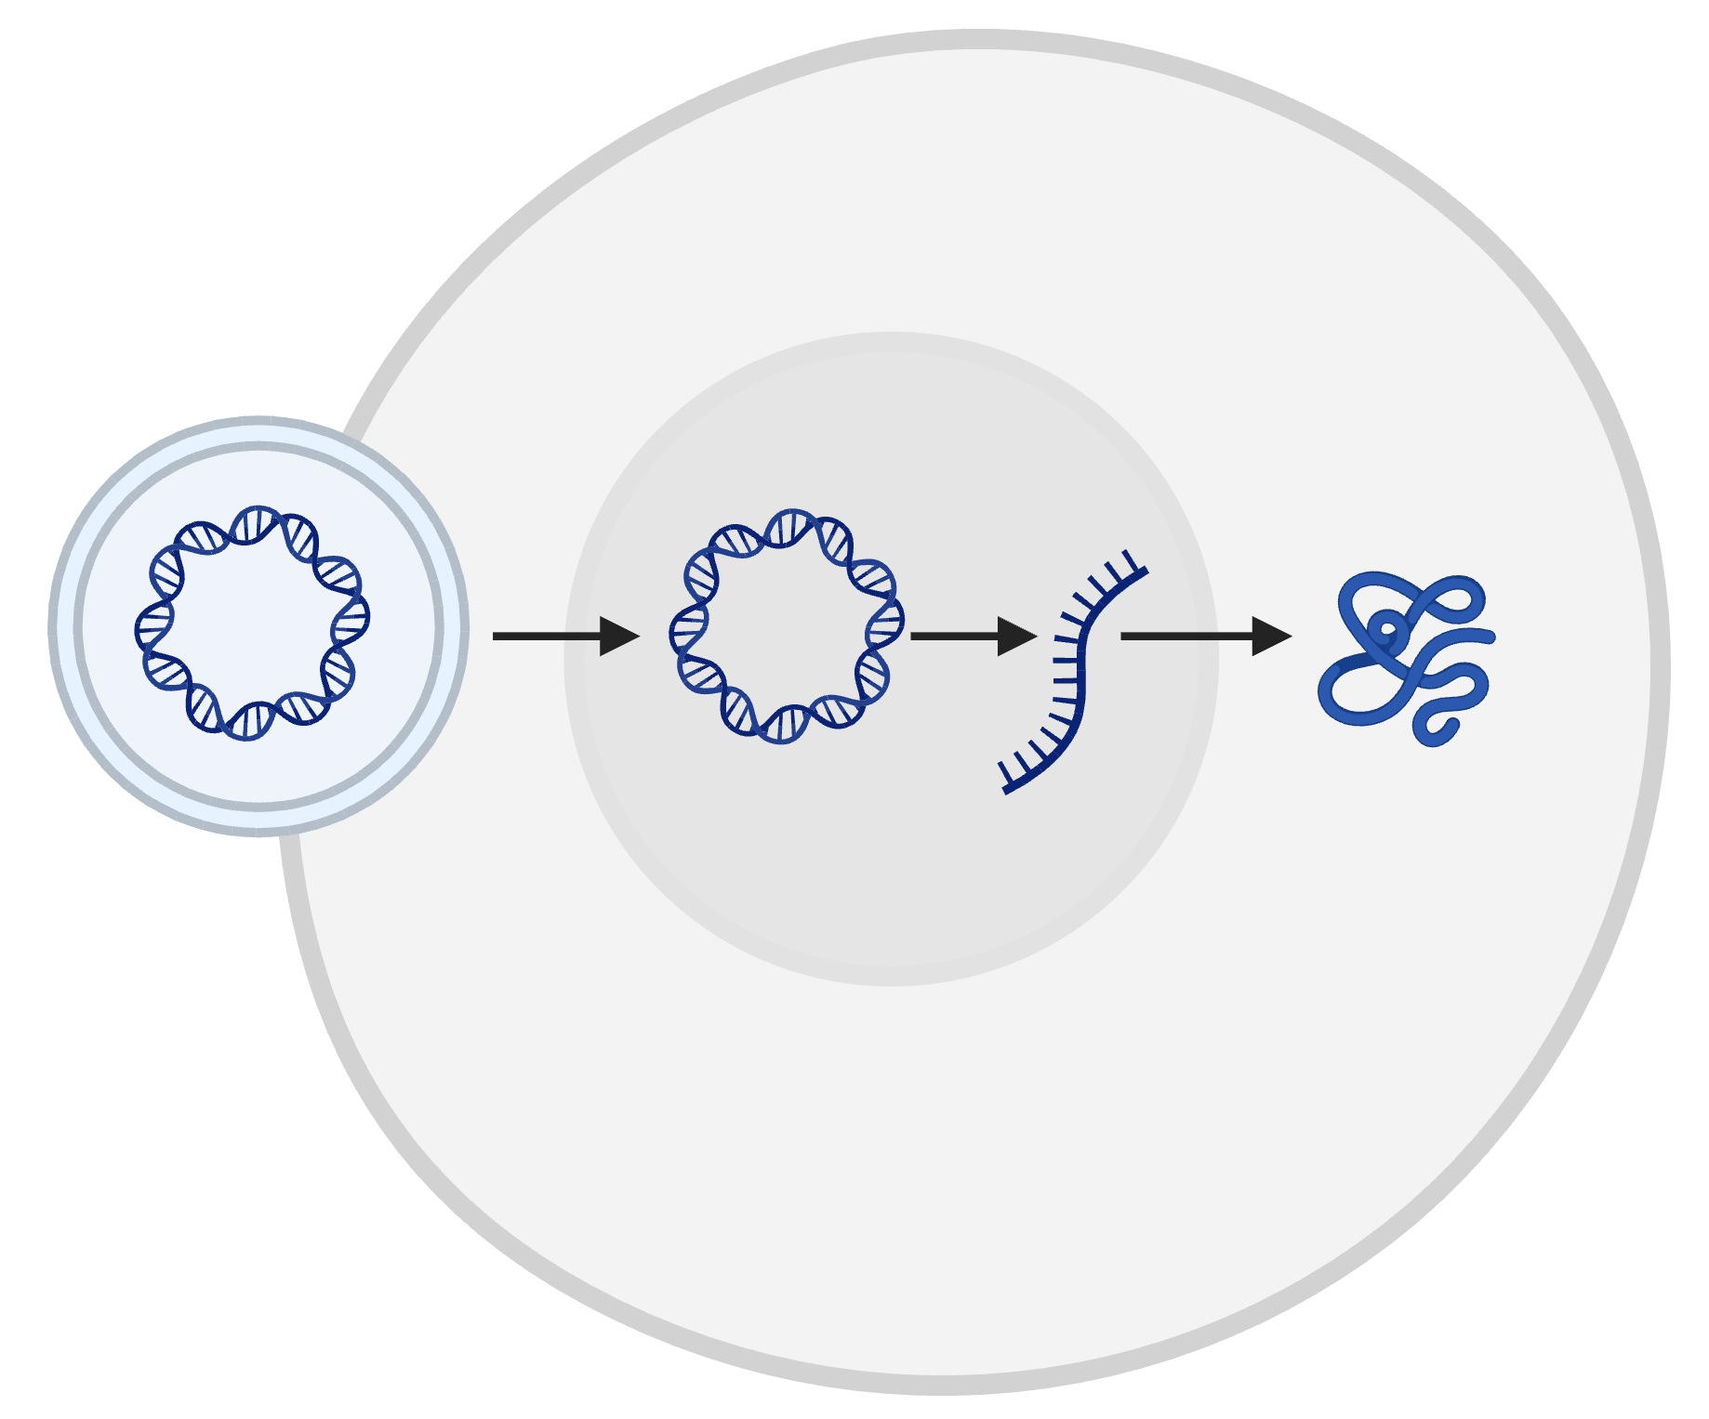
III
Methodology
Experiment Timeline (3/3)
11
12
13
14
15
Liquid Bacterial Growth
Miniprep 2
Quality Control Gel
Cell Transfection
Cell Plating
Notes:
After allowing for overnight growth on the agar plate we placed a single colony once more into a vial for liquid growth. After growing the bacteria we extracted our final DNA through miniprep. We then ran a quality control to verify we produced the correct sequence. We also seeded our plate to have similar cell counts to allow for cell transfection in our experiment.

Slide 12
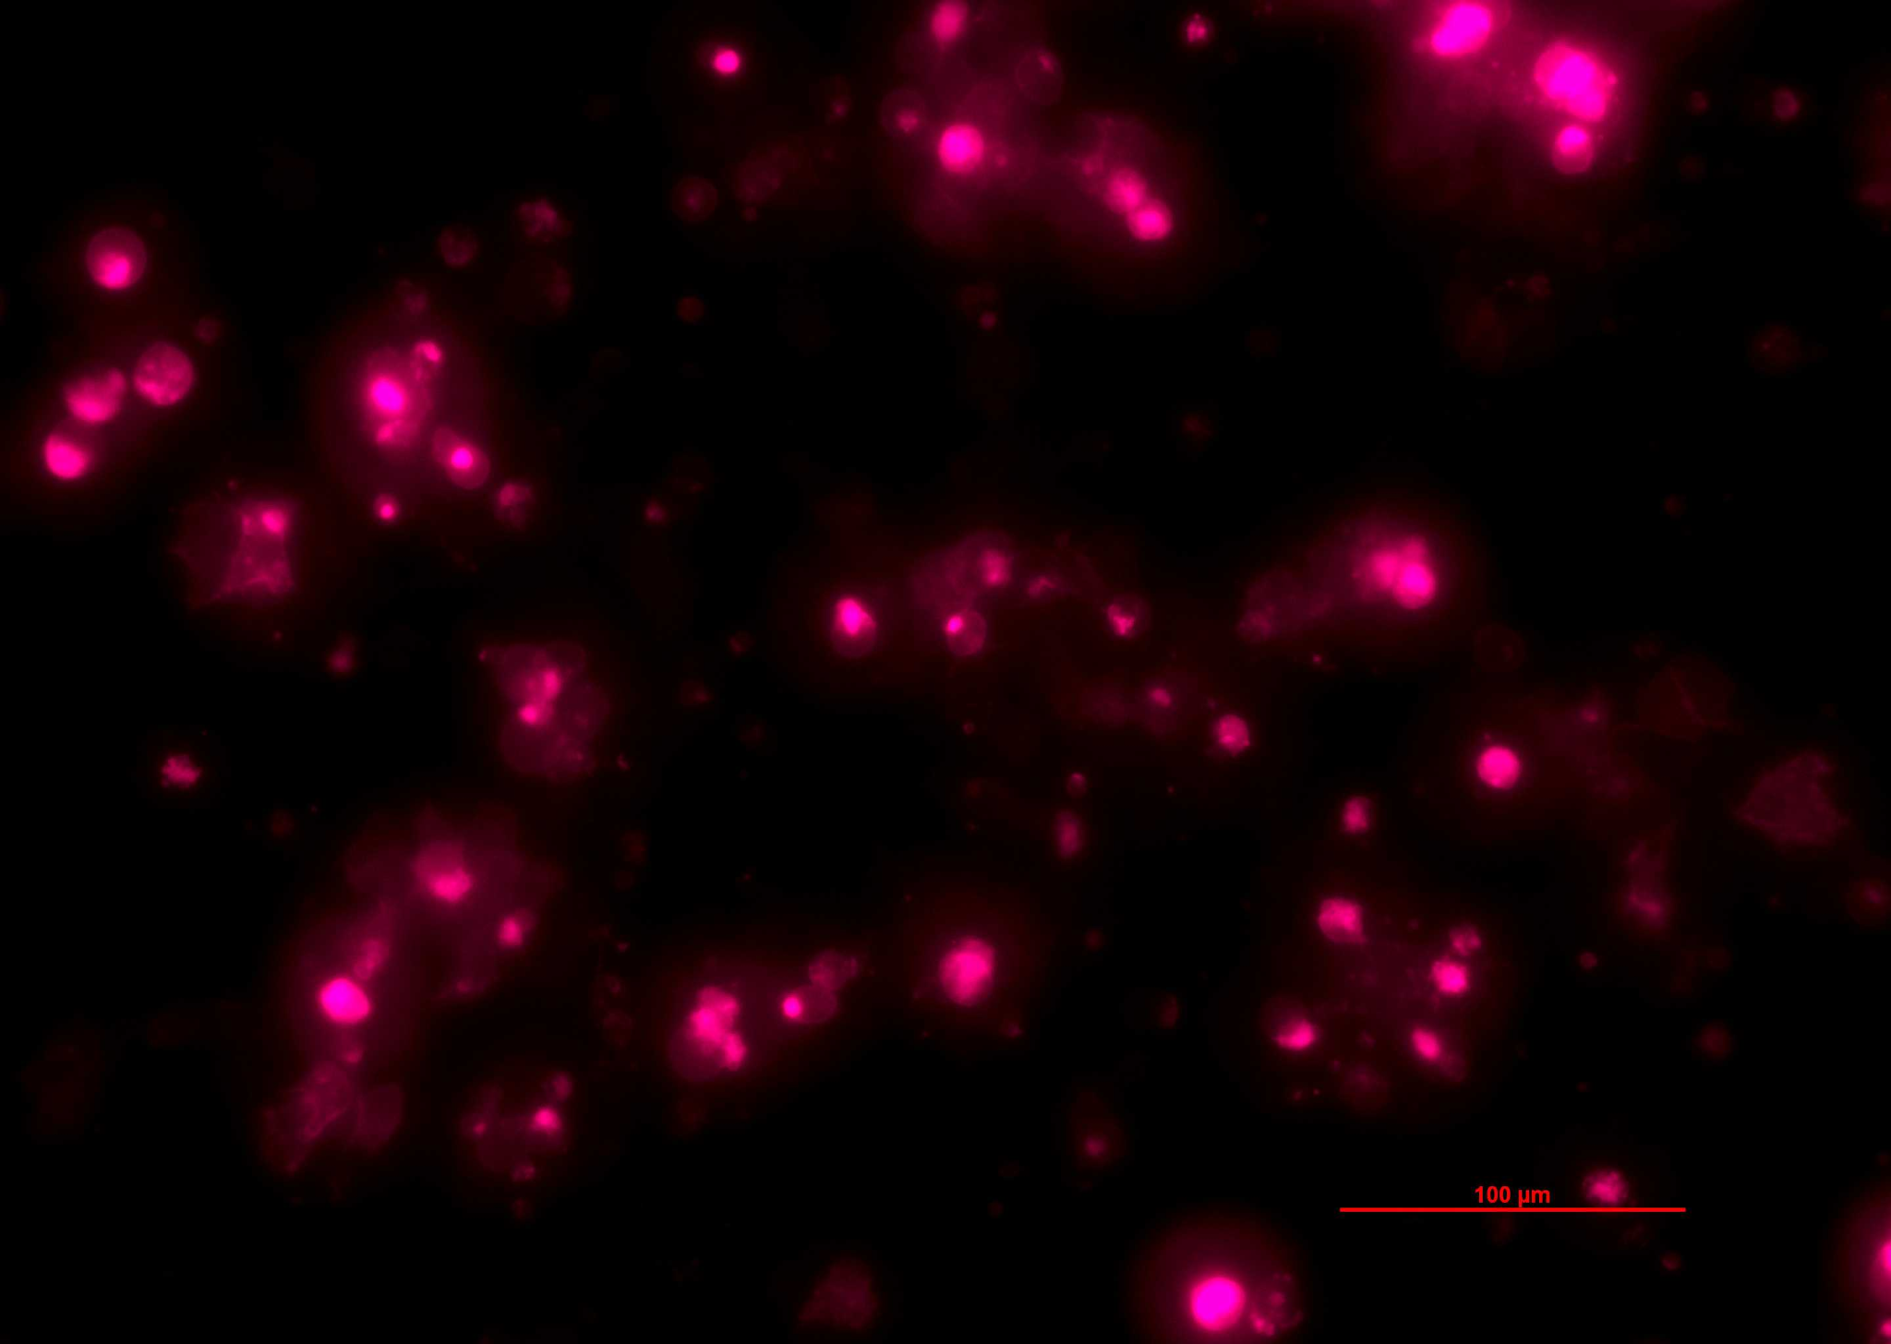
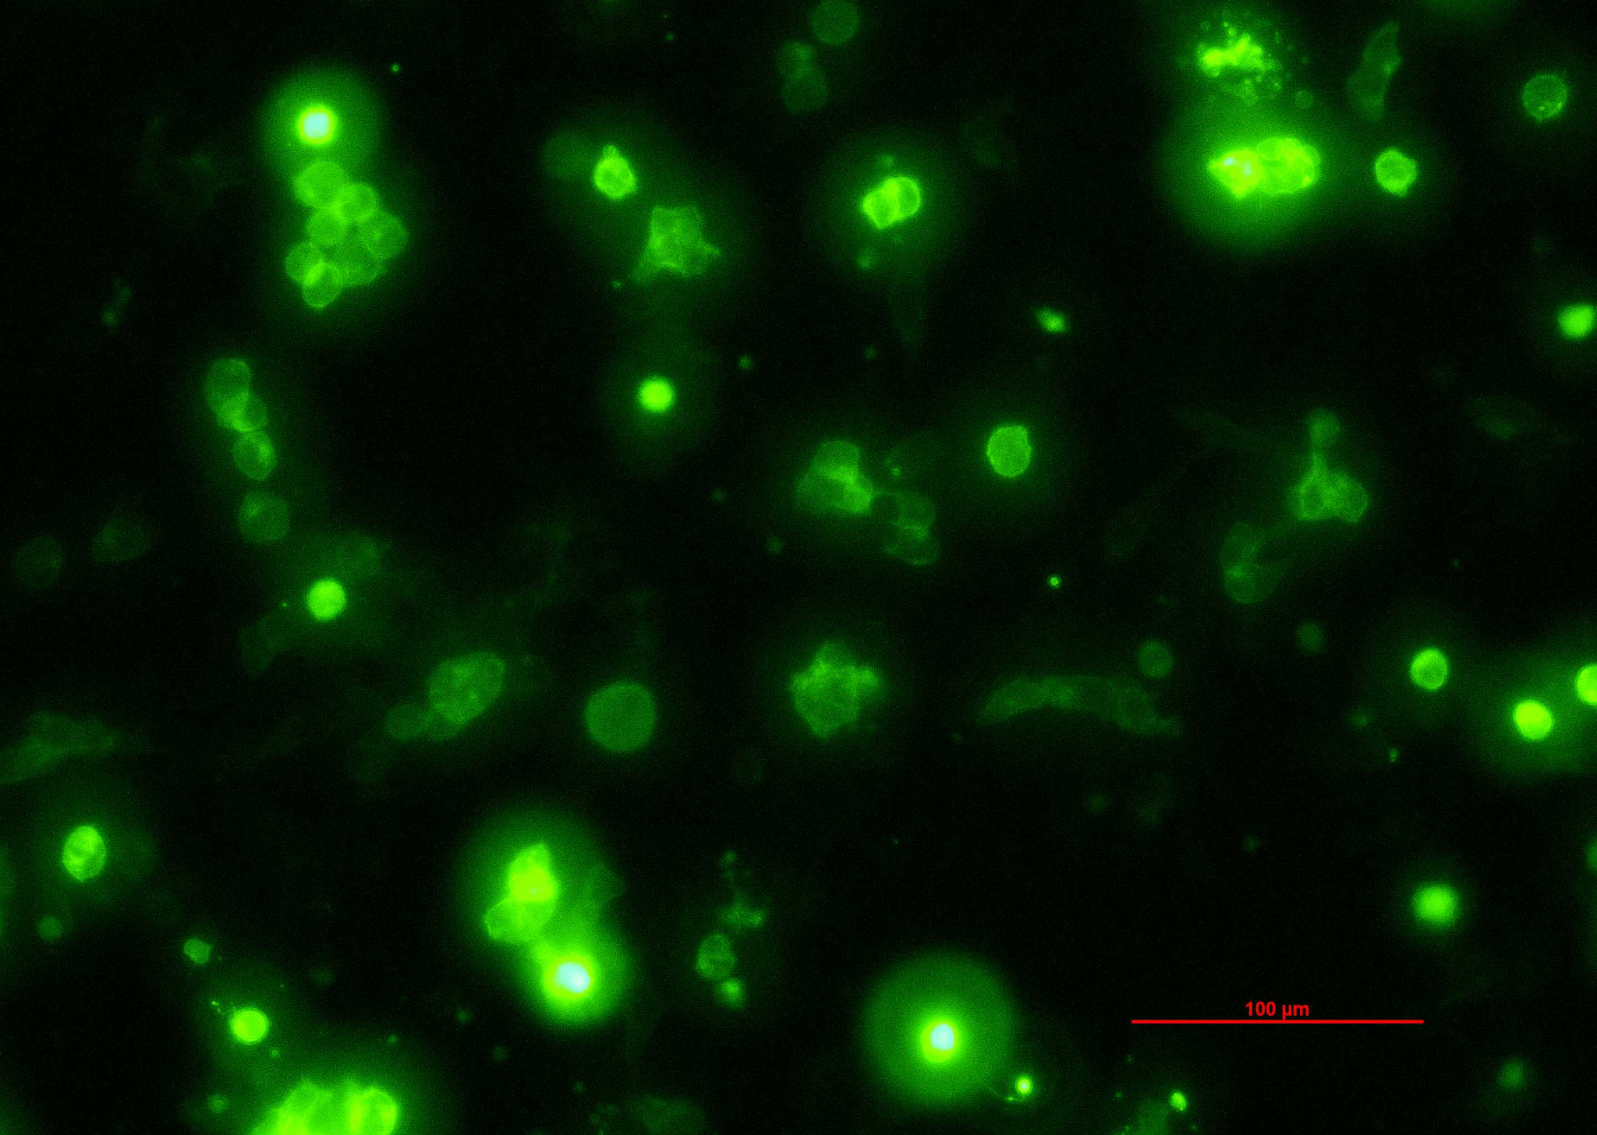
IV
Results
Results: Microscope Images
Notes:
Of our 5 devices, only the 2 from the first cycle worked correctly. The image on the left is our device with the CAG promoter with the one on the left being hEF1a; both target the cell cytoplasm. The remaining 3 devices from the second cycle did not work out, I’ll explain the reasons later in the conclusion.
The well on the left was given twice as much DNA as the one on the right. However the one on the left was also taken with an exposure time 4 times as much. It’s difficult to compare the 2 though as the fluorophores are different.

Slide 13
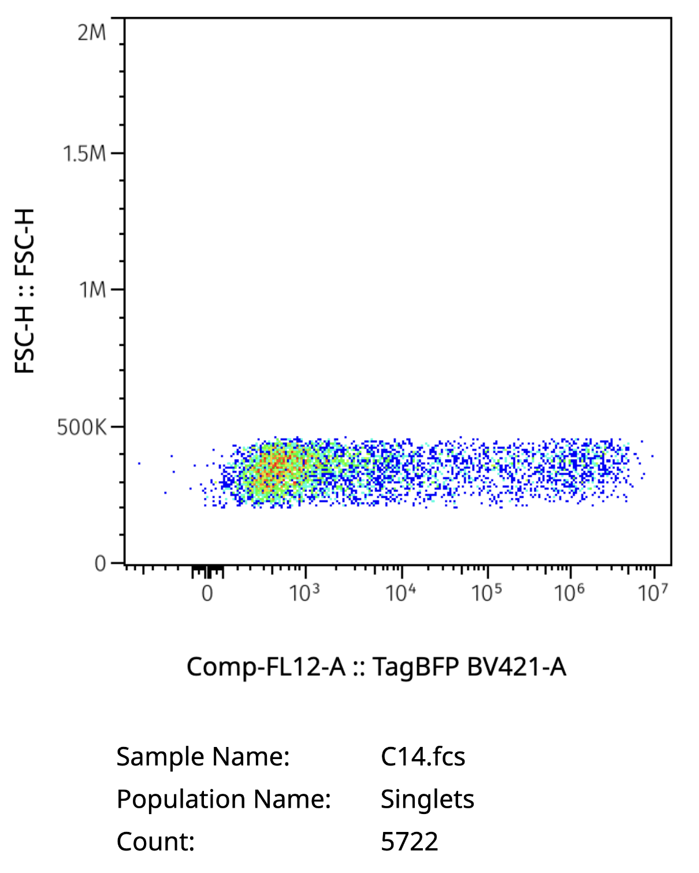
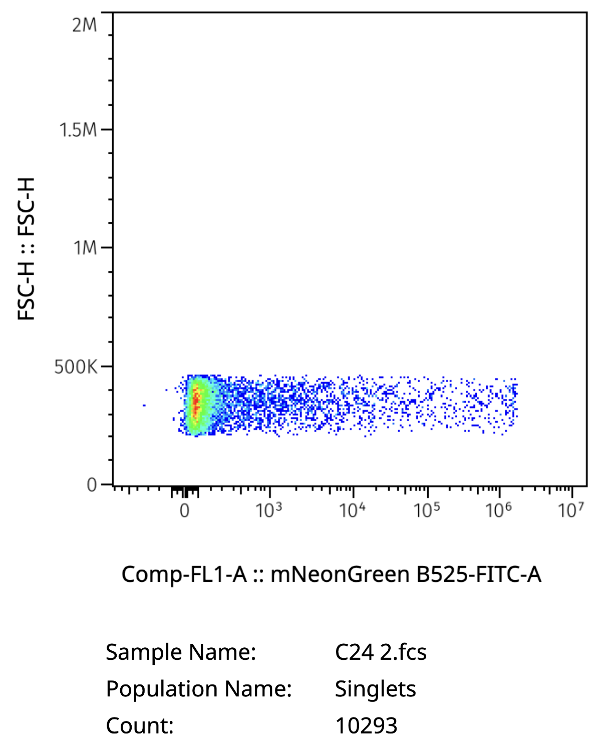
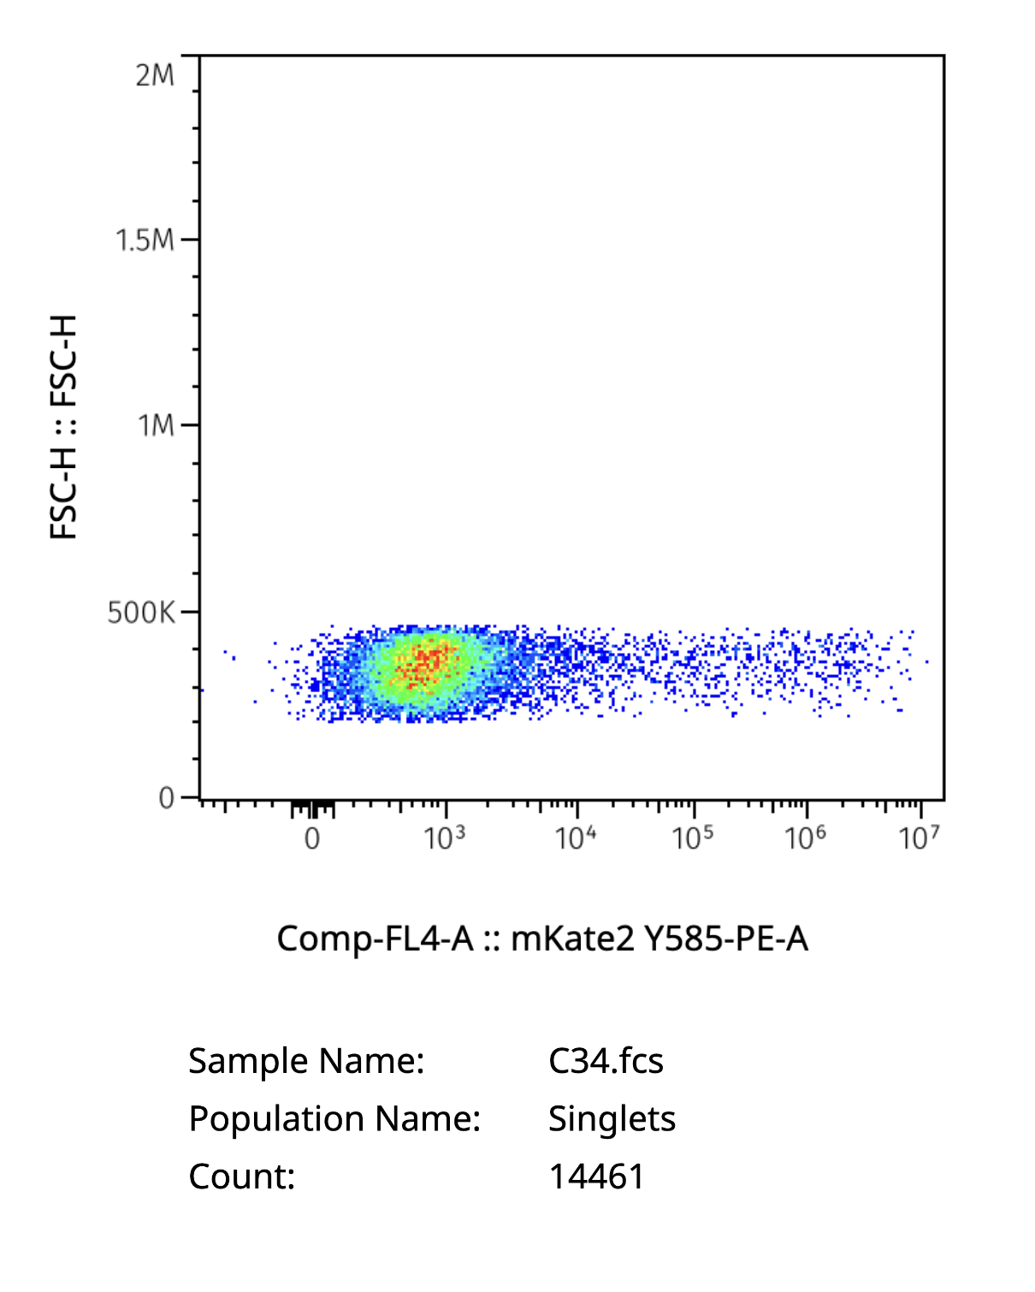
IV
Results
Results: Flow Cytometry Analysis (1/3)
Notes:
We did not get the chance to run flow cytometry on our cells, however we were given demo data to analyze instead. Here I have plotted the forward scatter height against the 3 colours for our positive controls. C14 was our Blue, C24 was our green and C34 was our red. The horizontal line indicates that we had cells presenting the target colour for each condition. The transition to green and red indicates more cells were at the lower end of the spectrum as expected. We don’t expect cells to take up a high level of devices, but rather only a few and follow the poisson distribution, which is what we see.

Slide 14
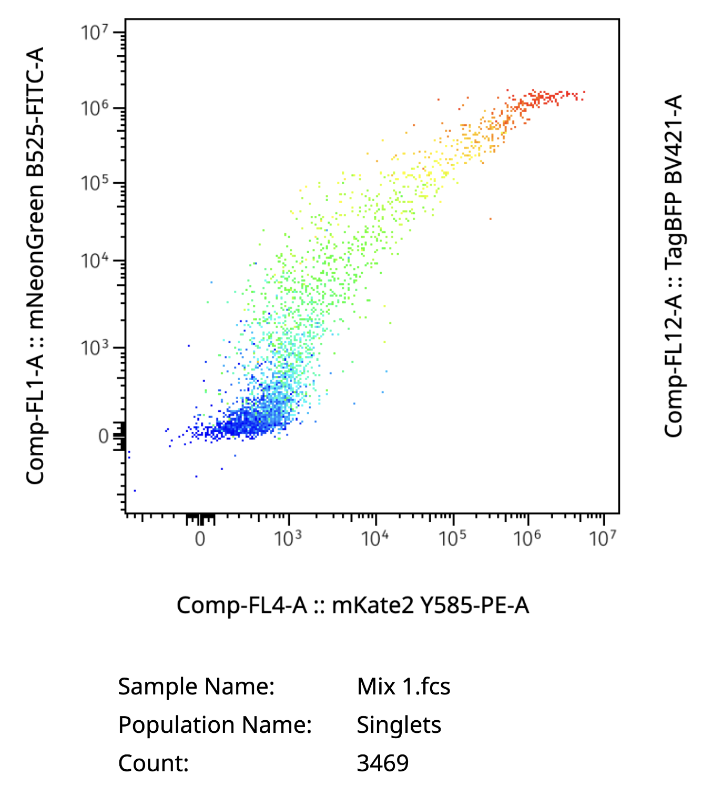
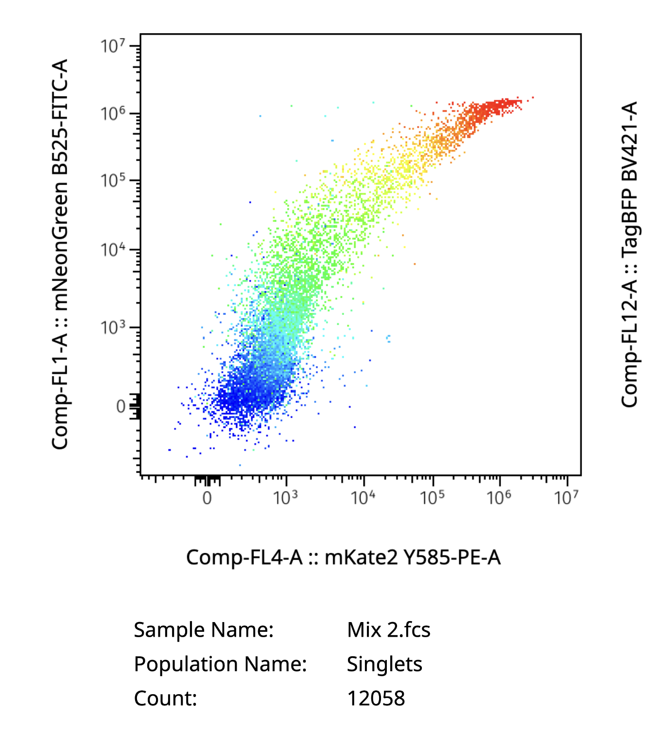
IV
Results
Results: Flow Cytometry Analysis (2/3)
Notes:
Here are our 2 mixes that we were provided to work with. The mixture on the left has a 1-1-1 ratio of blue, green & red.The one on the right has a ratio of 3 blue to 2 green and 1 red. The x axis on both is red while the y axis on both is green. The colour axis represents the strength of blue, lower levels are in blue with higher levels in red.
Though the plots may look similar, the distinction becomes more clear once we add a guideline through the center of both gradient plots. The plot on the left has a guideline through x=y, showing how equal levels of red and green appear. The equal split along the colours indicate a good spread as we expected in the 1-1-1 ratio.
The plot on the right (ignoring the colour for now), shows a shift upwards indicating more green than red, which we expect as there is 2 times as much green than red. The colour shift indicates lots of red in a very dense region compared to blue as expected. It’s difficult to ascertain precise quantities, but from what we do see the ratio is visible.
It’s difficult to compare the 2 plots directly as the density of cells is different (the one on the right has nearly 4 times as many cells).

Slide 15
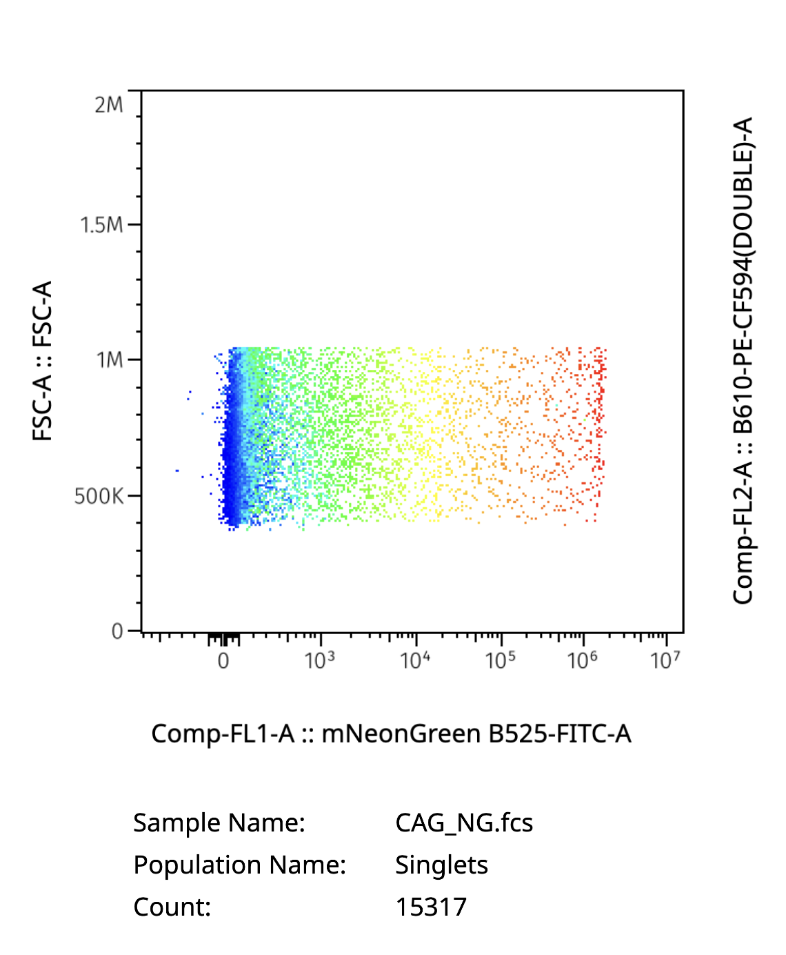
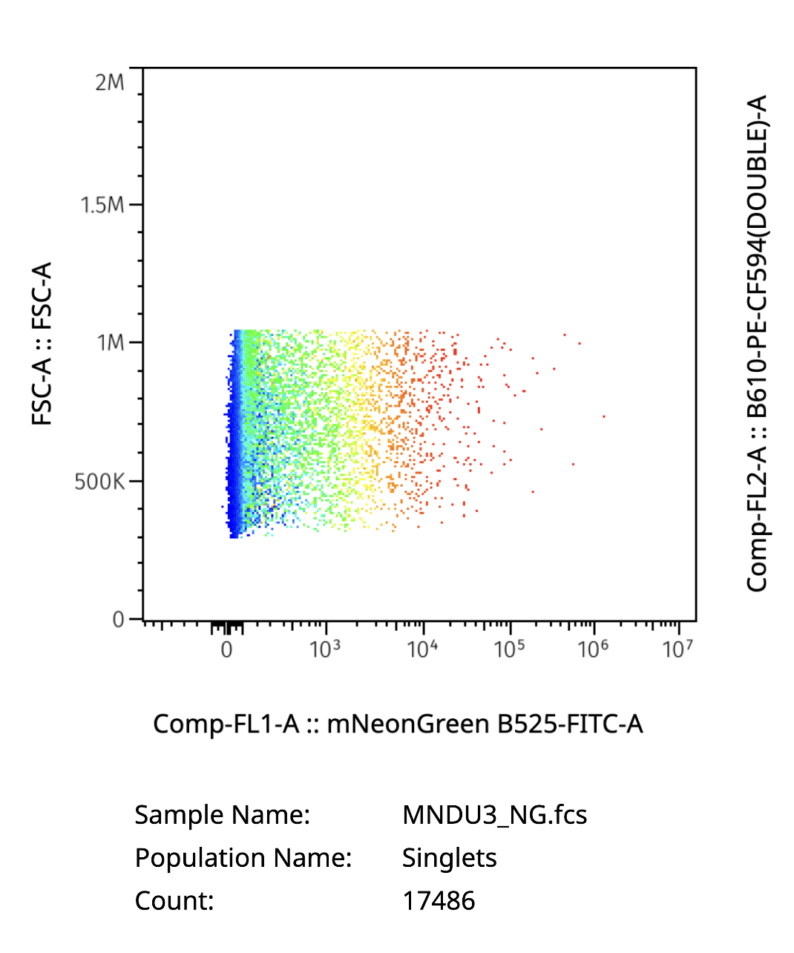
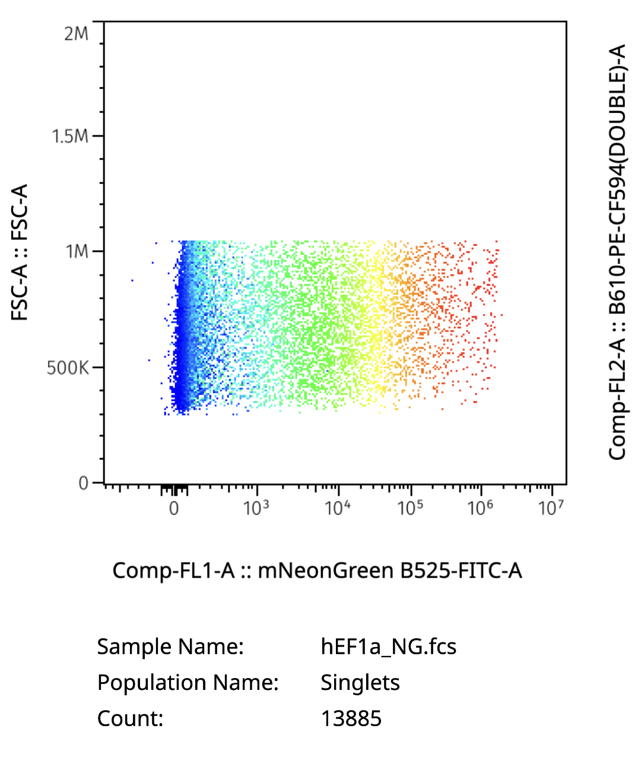
IV
Results
Results: Flow Cytometry Promoter Analysis (3/3)
Notes:
To compare our promoters, we have a different set of 3 flow data to analyze. Here I’ve plotted the Neon green against the forward scatter for the 3 promoters. These results indicate our CAG & hEF1a had similar results, while our MNDU3 had the lowest expression. Enformer had hypothesized CAG would have the highest expression, followed by MNDU3 and hEF1a. The results are first glance here show that CAG & hEF1a had the highest expression with MNDU3 with the lowest. As mentioned before Enformer had not been peer reviewed as of yet, and the model used was a rough estimator. Furthermore a direct comparison across these 3 promoters is difficult as the cell count varies across them. This is also a single experiment, and so it becomes difficult to assess the system equally. What is evident is that MNDU3 had the lowest expression among the 3.

Slide 16
V
Conclusion & Discussion
Conclusion
2 of our 5 devices worked successfully; both of which were from our first cycle of production.
The second wave failed to work at the final stage, however the issue must have been one at a much earlier stage. (Golden Gate)
It’s difficult to make a direct comparison though the promoters were different (4x exposure, double dose, no positive control)
Notes:
From the experiment, we found that 2 of our 5 devices were successful. Both of them were from our first cycle, indicating one cycle was fully successful. The second wave did not work, we suspect an error must have occured during our golden gate assembly. We had successful bacteria grow in our agar plates & liquid cultures, so they must have had a plasmid containing our antibiotic of resistance. The lack of fluorescence along with the quality check gel are clear indicators that our plasmid was not the one of interest.
Furthermore it’s difficult to compare our promoters directly as we had use different concentrations along with different exposures for imaging. A direct comparison would also require a positive control which we did not get to do.

Slide 17
Further Testing
V
Conclusion & Discussion
Potential Applications
The device could be tested in other cells to identify their impact
Proper experimentation with positive & negative controls could provide a better understanding of how different promoters act
A non-transient transfection method could be used to analyze how the cell takes in the new sequence.
Understanding the strength of different promoters can aid in simulating genetic circuits
A tag that correctly identifies the cell’s organelles (eg. mitochondria) could be used to classify cell type (eg. muscle vs fat cell)
It could be used to understand how organelles respond to environmental stimuli
Notes:
As for further testing, we could test our device in different types of cells to understand how the cellular environment could impact gene expression. Proper experimentation with positive & negative controls could clarify the strength of promoters. Performing a non-transient transfection method could help us to understand the long-term effect of the promoter on our genetic device as well.
Performing similar experiments is important as it can help us understand the strength of promoters & aid in simulating genetic circuits. A correct implementation could help us quickly identify cell type as different cell types have different concentration of certain organelles. Furthermore it could be used to understand how organelles in particular respond to environmental stimuli.

Slide 18
Thank you
Notes:
And that’s the end of my presentation. Thank you.

Slide 19
References
J. Lin, R. Luo, and L. Pinello, “EPInformer: A Scalable Deep Learning Framework for Gene Expression Prediction by Integrating Promoter-enhancer Sequences with Multimodal Epigenomic Data,” bioRxiv, Aug. 2024, doi: https://doi.org/10.1101/2024.08.01.606099.
S. Seal et al., “Cell Painting: a decade of discovery and innovation in cellular imaging,” Nature Methods, vol. 22, pp. 254–268, Dec. 2024, doi: https://doi.org/10.1038/s41592-024-02528-8.
Notes:
Here are the sources I used for this paper.

